Slide 1

Module 7 –Office Hrs with Raunak Goyal Nov 26, 2023

Slide 2
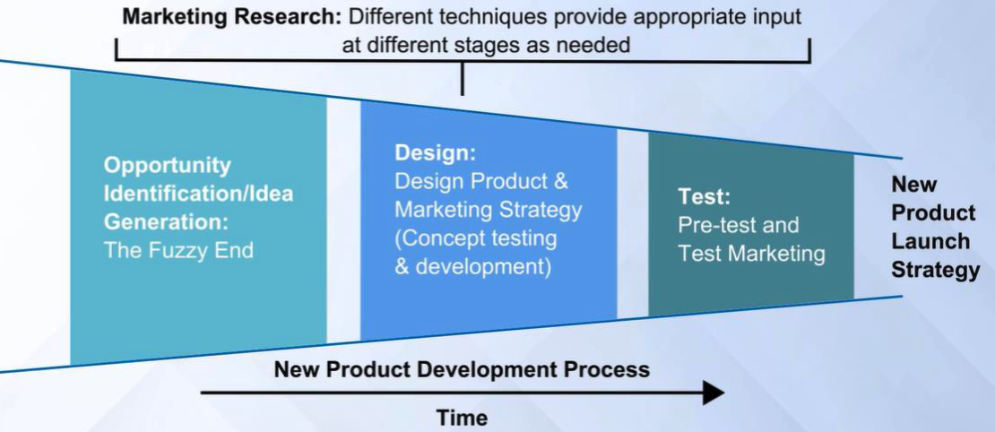
MODULE REVIEW – NEW PRODUCT DEVELOPMENT
Note that we are still in the design phase. This week we focus on Market Research to help guide your product development (Leading to roadmap and feature prioritization).
Notes:
Note that we are still in the design phase. This week we focus on Market Research to help guide your product development.

Slide 3
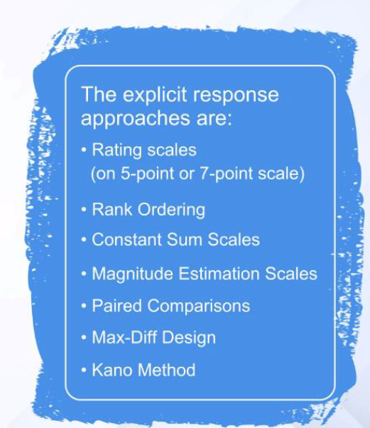
MODULE REVIEW – EXPLICIT RESPONSE APPROACHES
Recall that there were several product feature evaluation methods from the lectures. Let’s briefly touch on each of these with a more time spent on the one used for the assignment.
Notes:
Recall that there were a number of product feature evaluation methods from the lectures. Let’s briefly touch on each of these with a little more time spent on the one used for the assignment.

Slide 4
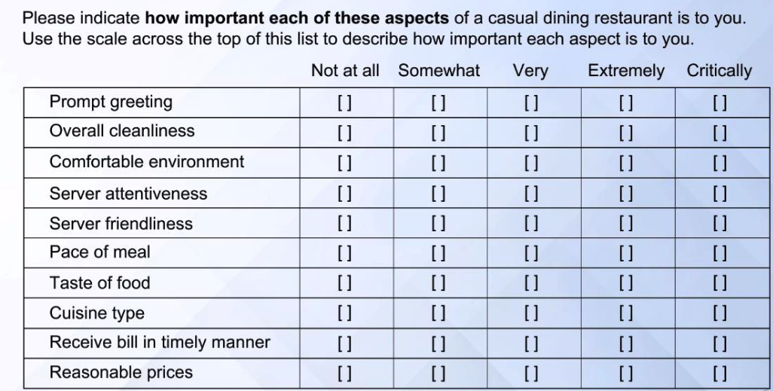
MODULE REVIEW – RATINGS SCALE
A rating scale enables the consumer to rate the product attributes on a scale. Note that in some respects this starts by assuming each of the items are unvalued and roughly equivalent. (Much too simplistic…)
Notes:
A rating scale enables the consumer to rate the product attributes on a scale. Note that in some respects this starts by assuming each of the items are unvalued and roughly equivalent.

Slide 5
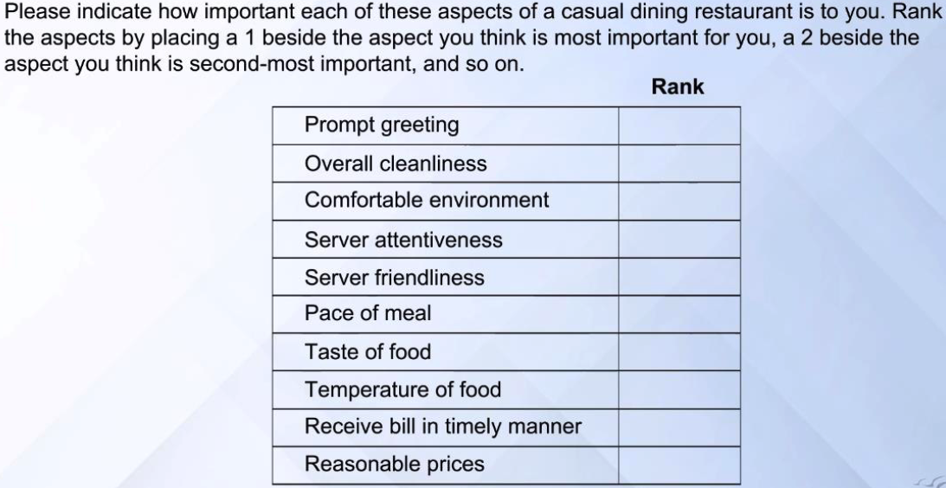
MODULE REVIEW – RANK ORDERING
This scale asks the customer to rank order each of the items in priority to them. This provides a little bit more precision on which of the items carries the most importance.
Notes:
This scale asks the customer to rank order each of the items in priority to them. This provides a little bit more precision on which of the items carries the most importance.

Slide 6
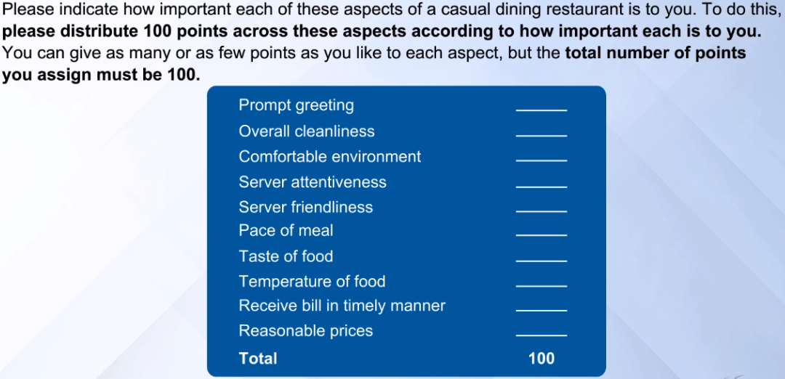
MODULE REVIEW – CONSTANT SUM SCALES
This type of scale enables the consumer to provide a weighting to each of the items measured. This can provide a bit more precision, particularly if one item truly stands out from the others.
Notes:
This type of scale enables the consumer to provide a weighting to each of the items measured. This can provide a bit more precision, particularly if one item truly stands out from the others.

Slide 7
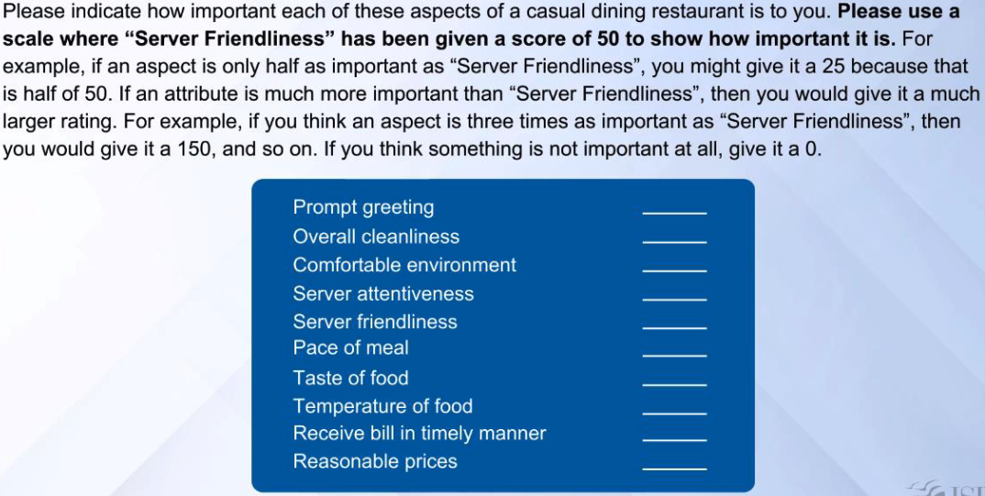
MODULE REVIEW – MAGNITUDE ESTIMATION SCALE
This is similar to the Constant Sum Scales though is tied to a particular measure, note how you do not ask that they allocate points from a pool. It is really a comparison of features/requirements.
Notes:
This is similar to the Constant Sum Scales though is tied to a particular measure, note how you do not ask that they allocate points from a pool. It is really a comparison of features/requirements.

Slide 8
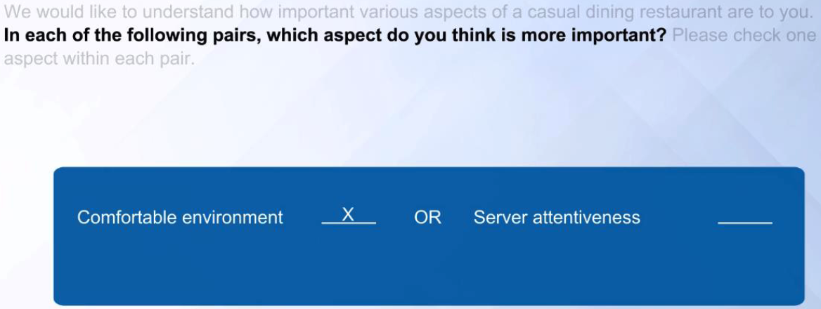
MODULE REVIEW – PAIRED COMPARISON
In this Methodology we ask the respondent to choose between two different features. The challenge is that both may be necessary to keep the customer satisfied, though it does provide great feed back when making direct trade offs
Notes:
In this Methodology we ask the respondent to choose between two different features. The challenge is that both may be necessary to keep the customer satisfied, though it does provide great feed back when making direct trade offs.

Slide 9
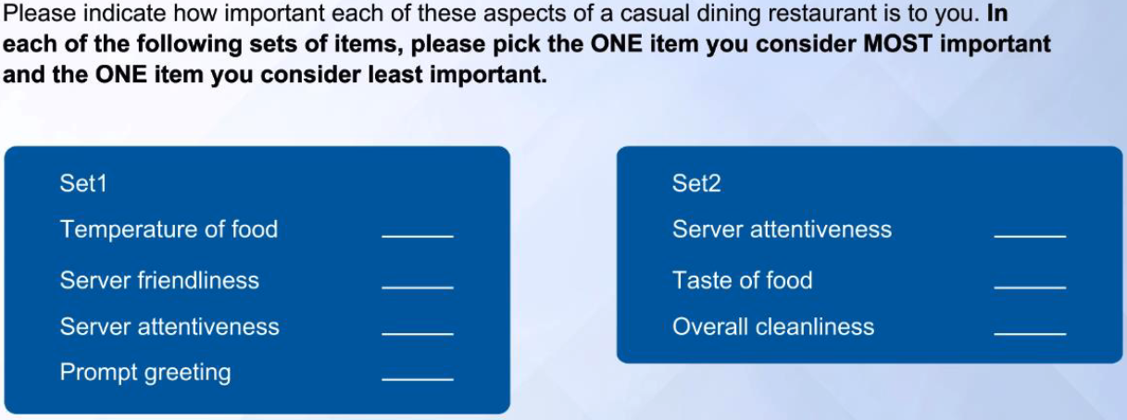
MODULE REVIEW – MAX-DIFF DESIGN
In this survey it is not a singular comparison, multiple features are ranked. A (semi)deeper dive into MAX-DIFF at the end of today’s session (time permitting))
Notes:
In this survey it is not a singular comparison, multiple features are ranked.

Slide 10
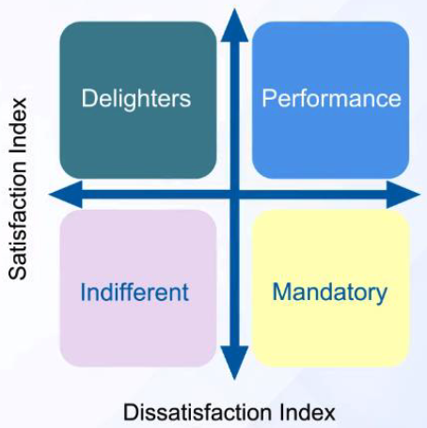
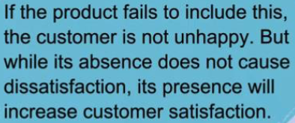

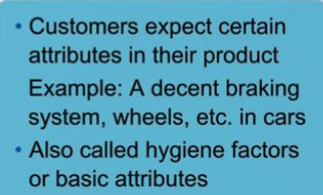
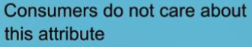
MODULE REVIEW – KANO CUSTOMER PREFERENCE MATRIX
Notes:
Now for the Kano Model/Method.
Each of the features are classified based upon this matrix, starting from the lower right and going counter-clockwise: CLICK
Mandatory Features – No matter how well the product meets the need, the customer expects it to be part of the product. Example, a decent braking system, wheels and an engine in a car. Think of these items as what you must have to be considered a car when you strip away the other features in a Disruptive Reverse Positioning exercise.
CLICK
Performance Features – The better the product is at meeting the need the better the customer likes the product. Quality attributes of the product, for example, the camera in the cellphone.
CLICK
Delighters – If the product fails to include this, the customer is not unhappy. But while its absence does not cause dissatisfaction, its presence will increase customer satisfaction. For example, the touchscreen in the original iPhone. It showed what a cellphone could be.
CLICK
Indifferent – Consumers do not care about this feature one way or another. The feature produces neither satisfaction or dissatisfaction regardless of whether it is in the product. Think of these items as potential items to remove in a Reverse positioning exercise.

Slide 11
Deeper-dive on Kano Model
Since Assignment 7.1 uses the Kano Model

Slide 12
Step-by-step guide to using the Kano Model - essence
Why? Creating a product roadmap
My experience – the mot important task of a PM
Roadmap, Prioritization, Release Train, Must-Have, Nice-to-have, Should-have
Your feature backlog is “endless” (So many internal and external “contributors” )
You want data to support your decisions
How to select the right features? Which ones will make your (future) customers “happy”?
So, how do we measure satisfaction (Kano Model is a useful tool)

Slide 13
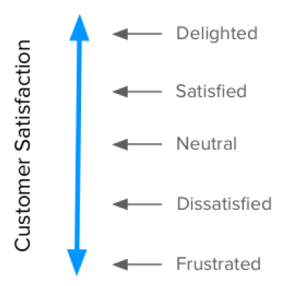
Step-by-step guide to using the Kano Model – In a nutshell
Features can be classified into four categories;
You can determine how customers feel
about a feature through a questionnaire
Satisfaction vs Functionality;
It all starts with our goal: Satisfaction.
Kano proposes a dimension that goes from
total satisfaction (also called Delight and Excitement)
to total dissatisfaction(or Frustration).
these two dimensions put together
are the basis of the Kano Model
and determine how our customers feel about our product’s features

Slide 14
Step-by-step guide to using the Kano Model - Categories
Kano classifies features into four categories, depending on how customers react to the provided level of Functionality. (Look at the graphs to understand…)
Performance: Some product features behave as what we might intuitively think that Satisfaction works: the more we provide, the more satisfied – Advice to PMs: The more you have of each of those, the greater your satisfaction
our customers become
Must-be: Other product features are simply expected
by customers. Advice to PMs: the slightest bit of investment
goes a long way in increasing satisfaction (but –
No matter what we invest in the feature, we won’t
ever make our customers more satisfied with the product
Attractive: There are unexpected features which, when
presented, cause a positive reaction. These are usually called
Attractive, Exciters or Delighters - Advice to PMs: (Select carefully)
Beyond a certain point ,we’re just over-killing it. (Note that they
decay!)
Indifferent: Naturally, there are also features towards which
we feel indifferent - Advice to PMs:
avoid working on these because they’re essentially a waste of effort

Slide 15
Step-by-step guide to using the Kano Model - Questions
Two questions for the features we want to evaluate:
One asks our customers how they feel if they have the feature; (the functional form)
The other asks how they feel if they did not have the feature, (the dysfunctional form)
“how do you feel if you had / did not have this feature”, the possible answers are:
I like it
I expect it
I am neutral
I can tolerate it
I dislike it

Slide 16
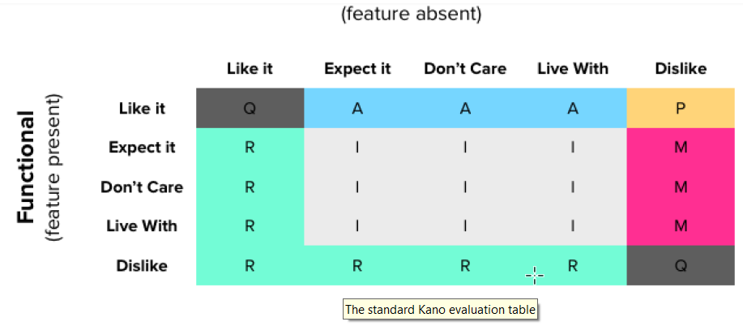
Step-by-step guide to using the Kano Model – Evaluation Table
One of the great things about the Kano model is that it accounts for both having and not having some functionality. This shows the extent to which something is actually wanted, needed or indifferent for our customers
The evaluation table that combines the functional and dysfunctional answers in its rows and columns (respectively)
Note the two NEW categories:
we’ll be able to tell if:
Someone has not fully understood the questions or feature we’re describing; (Questionable)
What we propose is actually the opposite of what they want. (Reverse)

Slide 17
Step-by-step guide to using the Kano Model – Populating the Table
(Note that the format of the table is slightly modified)
Performance features are the most straightforward to position. They are the ones where customers like having them and dislike not having
Must-be features are the remaining cases when a customer dislikes not having them
Attractive features are found when a customer likes having a feature that is not expected
Indifferent features occur for any “I’m neutral”
or “I can tolerate it” answer, for either the Functional
or Dysfunctional questions
Reverse answers positioned
along two axes
where reactions are either to
like not having the feature or
to dislike having it

Slide 18
Step-by-step guide to using the Kano Model – Scope (Practical Advice) – Part 1
Reminder: Our goal as Product Managers is to determine which features lead to more satisfied customers and use that information to help us prioritize what we need to build
Step 1: Choosing features and users for analysis
Choosing features: The features you choose to study should be those where the user will get any sort of meaningful benefit out of them (externally tangible features ). Your backlog will contain so many “technical” (Infrastructures) features. No user will understand those.
limit the number of features in the survey!
Selecting customers: When selecting customers (or prospects) to participate in your study, you must consider some demographic, logical cohort or persona to which they belong
If possible, map those who answer into early, late and non adopters
Pick the applicable segment (e.g.: in B2B SaaS, large enterprises will be different than small business

Slide 19
Step-by-step guide to using the Kano Model – Scope (Practical Advice) – Part 2
Step 2: Getting the (best possible) data from your customers
Write clear questions: Each should stand for a single feature
Your questions should be phrased in terms of benefits to the user, and not in terms of what the product will be able to do
Be careful with polar wording of question pairs. That is, the dysfunctional question is not necessarily the opposite of the functional one
Better than writing about features is to show them (Wireframe, Mockup)
Be mindful of the answers’ phrasing and understanding – Alternatives: (e.g.:
This would be very helpful to me; This is a basic requirement for me; This would not affect me;
This would be a minor inconvenience; This would be a major problem for me)
Test the questionnaire with some internal stakeholders, before presenting externally

Slide 20
Step-by-step guide to using the Kano Model - Analysis
Divide respondents by the demographic / persona criteria that defines them;
Categorize each respondent’s answers using the Evaluation table;
Tally the total responses in each category for each feature (and demographic);
Each feature’s category will be the most frequent response (i.e., the mode);
In case of close results between categories, use the following rule (leftmost wins):
Must-be > Performance > Attractive > Indifferent;
If you’ve asked respondents for a self-stated importance ranking (and you should), average that for each feature.
The table will look like the example on next slide

Slide 21
Step-by-step guide to using the Kano Model – Analysis - Table

Slide 22
Step-by-step guide to using the Kano Model – Satisfaction and Dissatisfaction coefficients
In most Kano resources, there are references to Satisfaction and Dissatisfaction coefficients
In other references, coefficients are named “Better” and “Worse” scores that reflected, in numerical terms, how customers’ satisfaction or dissatisfaction would change by the presence/absence of a feature
By considering the total number of answers in each category for agiven feature, they’re calculated using these formulas:
Use your judgement! Although they do produce a numerical result and are useful for relative comparisons, these coefficients have multiple issues:
These numbers come from using a single Kano category from each answer. This loss of information leads to higher variance in the data and equal weighting of all answers, independently of how strong or weak they are.

Slide 23
Step-by-step guide to using the Kano Model – Back to essence - Prioritization
The general prioritization rule of thumb presented in the analysis section still holds:
Must-be > Performance > Attractive > Indifferent.
This translates very well to graphical terms:

Slide 24
Some (pre-Assignment 7.1) references
https://www.qualtrics.com/experience-management/research/kano-analysis/
(You can use the Qualtrics SW tools (or similar)
https://foldingburritos.com/blog/kano-model
(You can use the link to the spreadsheet provide)
(My “step-by-step” was largely based on this link)
https://kanomodel.com/ - a full-service entity for Kano
https://usertimes.io/2019/01/21/how-to-run-studies-using-the-kano-method/#:~:text=The%20standardized%20Kano%20questionnaire%20proposes,lacks%20the%20feature%20in%20question
https://sapioresearch.com/kano-analysis/ - plus so many other service companies

Slide 25
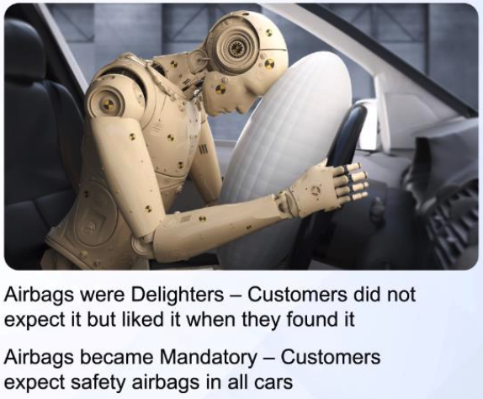
MODULE REVIEW (Repeat) – DELIGHTERS TRANSITION
Notes:
Delighters are great to help with Disruptive Breakaway positioning. Though over time, delighters have a way of transitioning to Mandatory requirements. The example provided in the lectures was of airbags in cars. A great safety feature that was a breakaway feature when it came out. Now, due to government requirements, it is a mandatory feature.
Similarly, if you were going to come out with a new cellphone today it requires a touchscreen . . . Until the next delighter that may displace it, perhaps voice recognition?

Slide 26
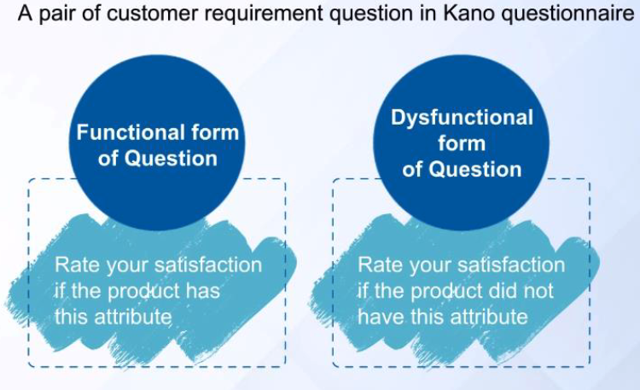
MODULE REVIEW (Repeat) – KANO FUNCTIONAL/DYSFUNCTIONAL
Notes:
The standardized Kano questionnaire proposes two questions that need to be answered for every feature. The functional questions measure users' reaction to the feature being present. The dysfunctional question measures users' reaction to a product that lacks the feature in question.
How to run studies using the Kano Method:
https://usertimes.io/2019/01/21/how-to-run-studies-using-the-kano-method/#:~:text=The%20standardized%20Kano%20questionnaire%20proposes,lacks%20the%20feature%20in%20question.

Slide 27
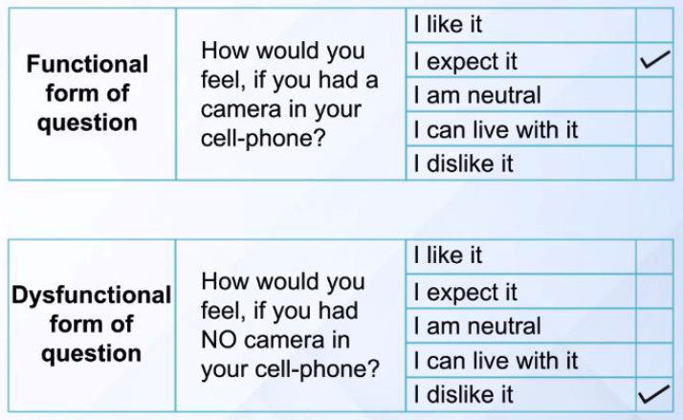
MODULE REVIEW (Repeat) – KANO QUESTIONNAIRE EXAMPLE
Notes:
This is a simple example of a Functional and Dysfunction survey for one particular feature of a phone.

Slide 28
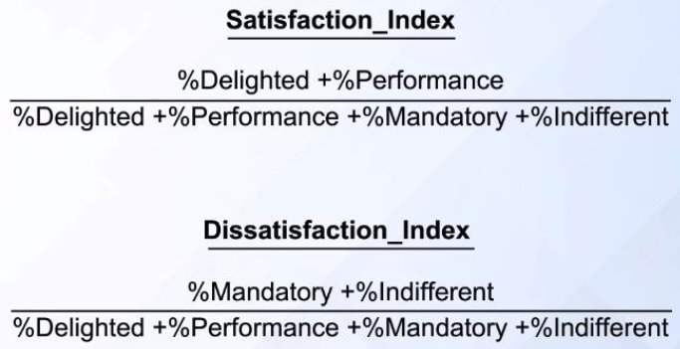
MODULE REVIEW (repeat) – CUSTOMER SATISFACTION
Notes:
I won’t go through all the math here, though the objective is to sort the data into different categories based upon the Satisfaction and Dissatisfaction Index.

Slide 29
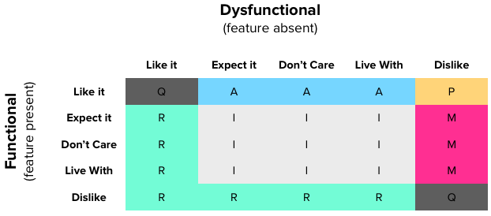
MODULE REVIEW (repeat) – KANO EVALUATION TABLE
Notes:
Once you have the data you should be able to sort the features into this table. This table will enable you to evaluate each feature into the following categories:
A — Attractive (Excitement/Delight)
O — One dimensional (Performance)
M — Must-be (or for us US based people, must have) (Threshold)
I — Indifferent
R — Reverse - So, they have a reverse effect on customer satisfaction. Kano model examples: Reverse requirements: A restaurant so crowded that it generates huge queues, may be good for the owner, but displeasing to customers. In a similar way, the smaller the internal space, the lower the satisfaction of vehicle owners
Q — Questionable (reflecting unclear results which cannot be graded).
Note, on the discussion board some of you have asked about this table vs the one in the lectures. The items in the table may need to be translated, some versions of the table list One-Dimensional, others will list P for Performance.
There is also a table entry that disagrees, the Dislike/Dislike entry. One table shows it as One-Dimentional and the other shows it as questionable. In doing a Google search for Kano Evaluation Table you will find most list that item as questionable . . . though

Slide 30
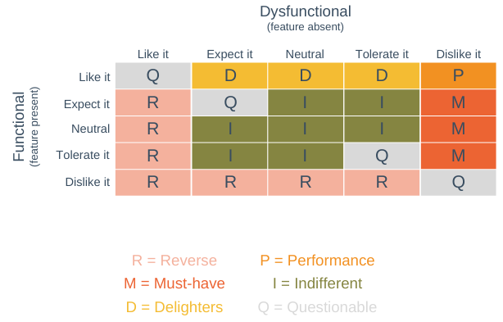
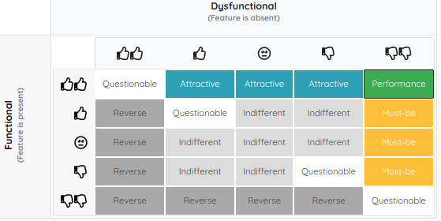
MODULE REVIEW (Repeat) – KANO EVALUATION TABLE
Notes:
CLICK
Here is one where a few more of the table entries show the feature is Questionable . . . Note the different notation.
CLICK
And another one that shows the same questionable boxes though different designations. Sometimes it is just different terminology.

Slide 31
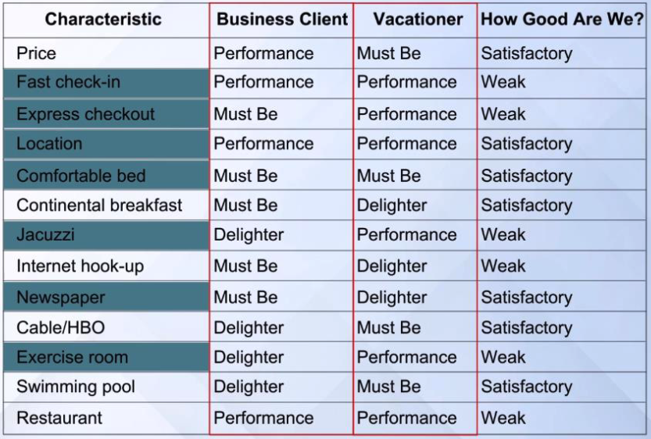
MODULE REVIEW (Repeat) – DIFFERENT SEGMENTS
Notes:
Different target customers may generate differences in the Kano Analysis.
This should not be surprising considering that each customer may be looking for a different “solution”, though we think of them as the same.

Slide 32
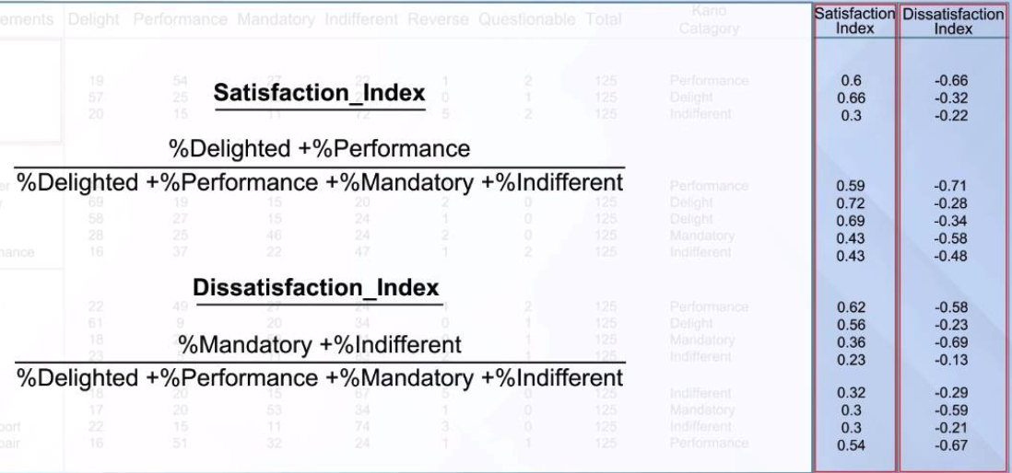
MODULE REVIEW (Repeat) – SATISFACTION/DISATIFICATION
Notes:
Back to the math to help with the sorting . . . Which

Slide 33
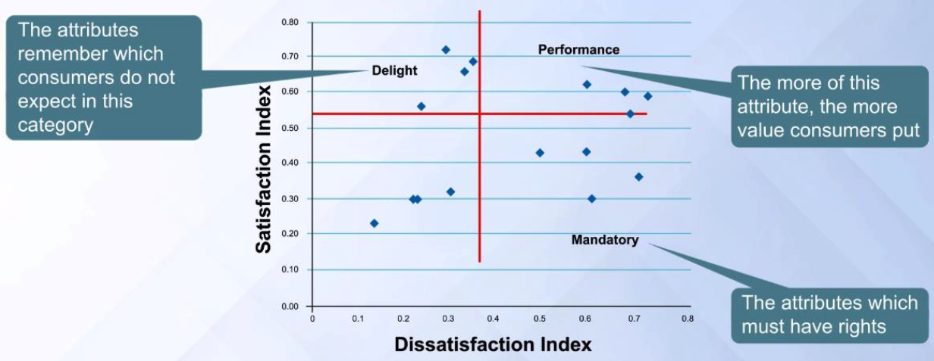
MODULE REVIEW (Repeat) – KANO MODEL
Notes:
. . . allows you to plot each of the features on this chart to help with the sorting.
With that as background let’s look at Assignment 7.1 . . .

Slide 34
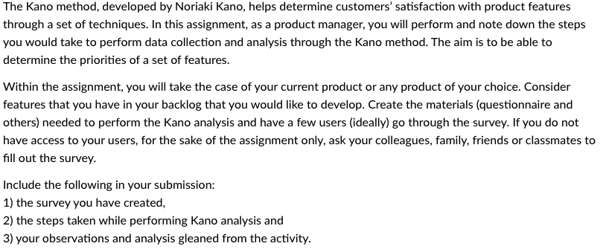
ASSIGNMENT 7.1 PROBLEM
Notes:
Determine the prioritizing features for product design to satisfy the customer needs by using the Kano Model.
CLICK
Assignment Instructions:
The Kano method, developed by Noriaki Kano, helps determine customers’ satisfaction with product features through a set of techniques. In this assignment, as a product manager, you will perform and note down the steps you would take to perform data collection and analysis through the Kano method. The aim is to be able to determine the priorities of a set of features.
Within the assignment, you will take the case of your current product or any product of your choice. Consider features that you have in your backlog that you would like to develop. Create the materials (questionnaire and others) needed to perform the Kano analysis and have a few users (ideally) go through the survey. If you do not have access to your users, for the sake of the assignment only, ask your colleagues, family, friends or classmates to fill out the survey.
CLICK
Then Include the following in your submission:
1) the survey you have created, 2) the steps taken while performing Kano analysis and 3) your observations and analysis gleaned from the activity.

Slide 35
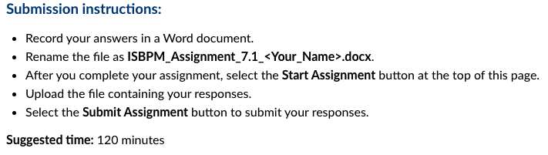
ASSIGNMENT 7.1 SUBMISSION
Notes:
For this assignment
The Submission instructions:
CLICK
Record your answers in a Word document.
Rename the file as ISBPM_Assignment_7.1_<Your_Name>.docx.
After you complete your assignment, select the Start Assignment button at the top of this page.
Upload the file containing your responses.
Select the Submit Assignment button to submit your responses.
And CLICK
Suggested time: 120 minutes
Let’s take a look at the items on the template and use that for discussion.

Slide 36
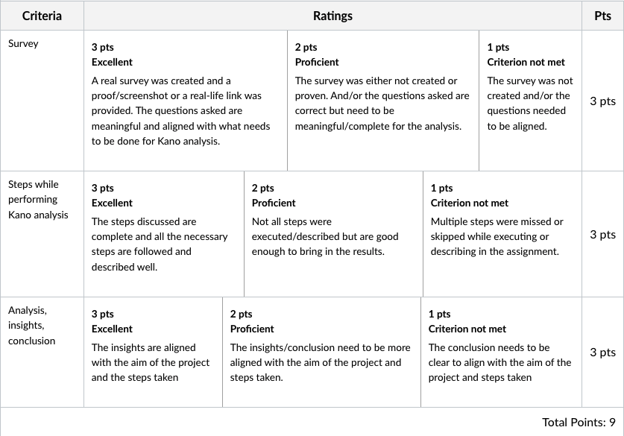
ASSIGNMENT 7.1 Rubric
Notes:
This assignment
CLICK
has a total of 3 criteria, each worth 3 points for a total of 9 points.
We’ll use each of the criteria for the discussion . . .

Slide 37
ASSIGNMENT 7.1 Criteria
Survey
Steps while performing Kano analysis
Analysis, insights, conclusion
Notes:
CLICK
Survey
Did you pose functional and dysfunctional questions
Step 1: Define features and user groups.
CLICK
Steps while performing Kano analysis
Step 1: Define features and user groups.
Step 2: Get user feedback
This comprises two steps:
Prepare your questions
Get user feedback
Step 3: Map Feedback and Grading Features
A Attractive E Expected O One dimensional I Indifferent R Reverse Q Questionable (reflecting unclear results which cannot be graded).
CLICK
Analysis, insights, conclusion
After your analysis, what are the most important insights? These should be somewhat unique to each product. Here are a few thoughts:
Do some of the grouping stand out as highly correlated?
Is there a high level message in the resulting grouping?
How else can it help with the product?
Using the toothpaste example from the lectures this week let me suggest that perhaps product positioning, in particular break-away positioning in some cases.

Slide 38
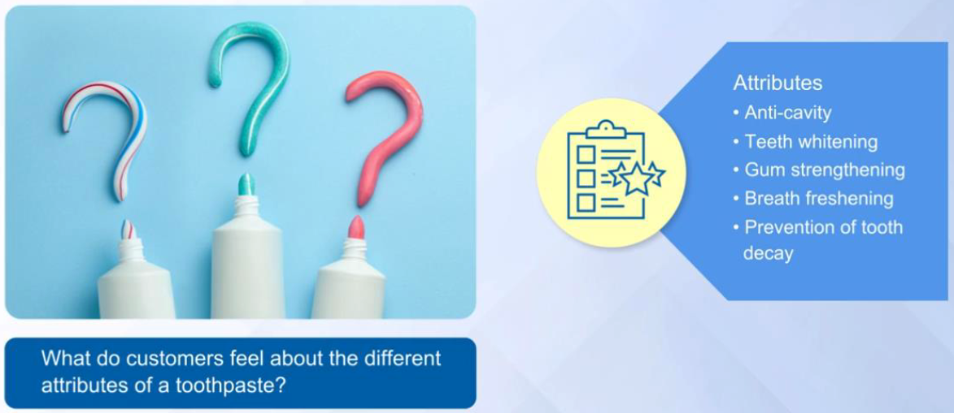
MODULE REVIEW – FACTOR ANALYSIS
Factor analysis is used to uncover the latent structure of a set of variables. It reduces attribute space from a large no. of variables to a smaller no. of factors and as such is a nondependent procedure.

Slide 39
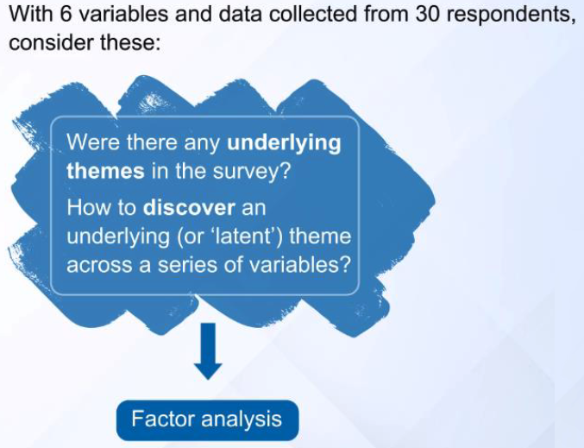
MODULE REVIEW – FACTOR ANALYSIS
The theory is that there are deeper factors driving the underlying concepts in your data, and that you can uncover and work with these instead of dealing with the lower-level variables that cascade from them. Factor analysis is also sometimes called “dimension reduction (Math is non-trivial)

Slide 40
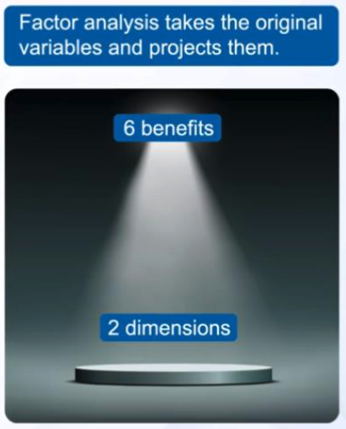
MODULE REVIEW – FACTOR ANALYSIS
6 into 2 is easy…Factor analysis is one of the unsupervised machine learning algorithms which is used for dimensionality reduction. This algorithm creates factors from the observed variables to represent the common variance i.e. variance due to correlation among the observed variables
Notes:
Factor analysis enables you to gain some insight on the factors, whether there are correlations and perhaps ways to change your perspective on the factors. With this in mind let’s take a look at the Self-Study assignment . . .

Slide 41
SELF-STUDY ASSIGNMENT 7.2 – PROBLEM
Discover the consumer latent needs through the factor analysis method.
Assignment Instructions:
Factor analysis is a method used to simplify complex data into insights, find clusters and associated variables, and patterns. In this assignment, you will perform factor analysis on the given data on toothpaste choices and determine what type of toothpaste is much liked by each survey responder using the Factor Analysis app.
App: Factor Analysis App (Links to an external site.)
You will be redirected to zero code learning platform where you can access the app. Login credentials will be available in your mailbox. In case you have trouble accessing the app, please write to: programme.support@eruditus.com
Corpus: Toothpaste Data.csv Download Toothpaste Data.csv
Key questions:
What kinds of toothpaste gel well together? For example, do anti-cavity and gum-strengthening properties go together? Or tooth-decay and whiten-teeth? Do people who like toothpaste with fresh breath also like anti-cavity properties in their toothpaste?
What do the Factor Scores say about individual respondents?
Suggested time: 90 minutes
Notes:
Go to the screen with the data loaded?
Discover the consumer latent needs through the factor analysis method.
Assignment Instructions:
Factor analysis is a method used to simplify complex data into insights, find clusters and associated variables, and patterns. In this assignment, you will perform factor analysis on the given data on toothpaste choices and determine what type of toothpaste is much liked by each survey responder using the Factor Analysis app.
App: Factor Analysis App (Links to an external site.)
You will be redirected to zero code learning platform where you can access the app. Login credentials will be available in your mailbox. In case you have trouble accessing the app, please write to: programme.support@eruditus.com
Corpus: Toothpaste Data.csv Download Toothpaste Data.csv
Key questions:
What kinds of toothpaste gel well together? For example, do anti-cavity and gum-strengthening properties go together? Or tooth-decay and whiten-teeth? Do people who like toothpaste with fresh breath also like anti-cavity properties in their toothpaste?
What do the Factor Scores say about individual respondents?
Suggested time: 90 minutes

Slide 42
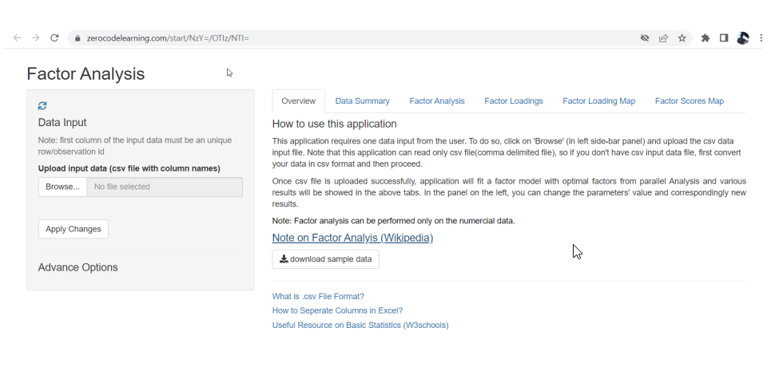
Factor Analysis App
Or… Use Python..
https://towardsdatascience.com/factor-analysis-a-complete-tutorial-1b7621890e42
https://www.analyticsvidhya.com/blog/2020/10/dimensionality-reduction-using-factor-analysis-in-python/
Notes:
Go to the screen with the data loaded?
Discover the consumer latent needs through the factor analysis method.
Assignment Instructions:
Factor analysis is a method used to simplify complex data into insights, find clusters and associated variables, and patterns. In this assignment, you will perform factor analysis on the given data on toothpaste choices and determine what type of toothpaste is much liked by each survey responder using the Factor Analysis app.
App: Factor Analysis App (Links to an external site.)
You will be redirected to zero code learning platform where you can access the app. Login credentials will be available in your mailbox. In case you have trouble accessing the app, please write to: programme.support@eruditus.com
Corpus: Toothpaste Data.csv Download Toothpaste Data.csv
Key questions:
What kinds of toothpaste gel well together? For example, do anti-cavity and gum-strengthening properties go together? Or tooth-decay and whiten-teeth? Do people who like toothpaste with fresh breath also like anti-cavity properties in their toothpaste?
What do the Factor Scores say about individual respondents?
Suggested time: 90 minutes

Slide 43
Additional discussion about MAX-DIFF
Suggest using a service company:
e.g.: https://conjointly.com/products/maxdiff-analysis/
:
MaxDiff is a statistical technique that creates a robust ranking of different items, such as product features. MaxDiff is an alternative to conjoint analysis (Next module), from which the respondent has to indicate which feature is most important or most desirable, and which is least important or desirable.
Testing of multiple attributes in the same survey
Brand-Specific combinations of attributes for when each brand is substantially different (to enable that, first create a Brand-Specific Conjoint and then convert it into the MaxDiff variety)
Simulation of preference shares, at a highly indicative level

Slide 44
Beyond Surveys – about effort (sizing)
One major critical component that you will encounter when working in a product team is the trade off required for the actual development of certain features. Assume for a moment feature A is the highest ranked feature to add to the product though it will take 3 engineers 2 years to build. The next 4 highest priority Features B, C, D and E would take 2 engineers 6 months to develop. What should you do?
Provided feature A was not a “Must Have” then most product managers would trade off the budget and time to market components and go to market with Features B, C, D and E while beginning work on Feature A.

Slide 45
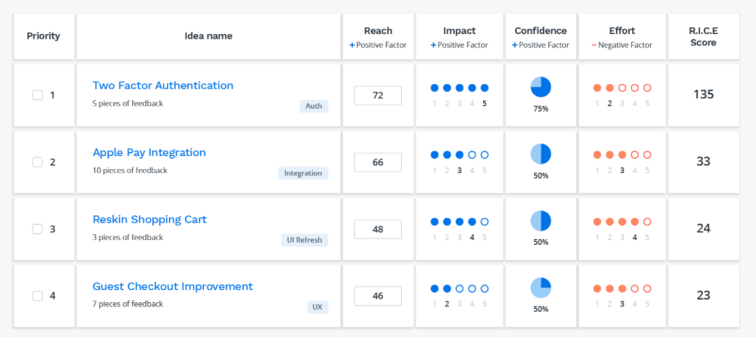
PRIORITIZATION USING RICE MATRIX IS A SIMPLIFICATION
Reach – how many customers will be impacted by this features
Impact – 3 – massive impact, 2 – high impact, 1 – medium impact
Confidence – Your personal confidence on the importance of the feature
Effort – how much effort needed to build the feature
Score = R x I x C
------------
E
If effort is high, you need higher R, I & C to make it worth the effort
Notes:
Reach – how many customers will be impacted by this features
Impact – 3 – massive impact, 2 – high impact, 1 – medium impact
Confidence – Your personal confidence on the importance of the feature
Effort – how much effort needed to build the feature
Score = R x I x C
------------
E
If effort is high, you need higher R, I & C to make it worth the effort

Slide 46
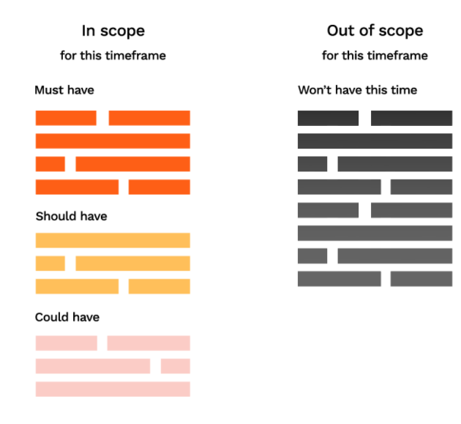
At the end, mostly PMs just publish: MoSCoW
Brevity is key since most statehooders: (a) suffer from ADD (b) Lack Technical Depth.
It allows you to think about resource allocation when you classify your features and requirements into each bucket.
Notes:
It’s good for involving stakeholders without a technical background in the product prioritization process.
Quick, easy and intuitive way of communicating priorities to the team and the customers.
It allows you to think about resource allocation when you classify your features and requirements into each bucket.
Must Have
Should Have
Nice to Have

Slide 47


ADDITIONAL RESOURCES
The Kano method Is good provided you run a good study:
Usertimes has a good article, How to run studies using the Kano Method.
https://usertimes.io/2019/01/21/how-to-run-studies-using-the-kano-method/#:~:text=The%20standardized%20Kano%20questionnaire%20proposes,lacks%20the%20feature%20in%20question
Additionally, you will often find some great presentations on SlideShare.
Here is one on the Kano Method and the Agile development methodology:
https://www.slideshare.net/jgoodpas/being-agile-with-kano-analysis?qid=9ff45357-2f21-42b5-97e8-0ec6906c7d2d&v=&b=&from_search=1
Notes:
The Kano method Is good provided you run a good study:
Usertimes has a good article, How to run studies using the Kano Method.
https://usertimes.io/2019/01/21/how-to-run-studies-using-the-kano-method/#:~:text=The%20standardized%20Kano%20questionnaire%20proposes,lacks%20the%20feature%20in%20question.
Additionally, you will often find some great presentations on SlideShare.
Here is one on the Kano Method and the Agile development methodology:
https://www.slideshare.net/jgoodpas/being-agile-with-kano-analysis?qid=9ff45357-2f21-42b5-97e8-0ec6906c7d2d&v=&b=&from_search=1

Slide 48


ADDITIONAL RESOURCES
One of your classmates recommended a very good article on prioritization from the Product School blog.
https://productschool.com/blog/product-management-2/skills/prioritization-techniques-product-managers/
Slack has some open groups where you can have peer discussions with other product managers . . . Here is a link to a Medium article that provides some different channels.
https://medium.com/getting-started-in-product/6-slack-groups-for-product-managers-c44f1e54b6f8
Notes:
One of your classmates recommended a very good article on prioritization from the Product School blog.
https://productschool.com/blog/product-management-2/skills/prioritization-techniques-product-managers/
Taking this advice further, there are lots of great resources out there, many are free.
Slack has some open groups where you can have peer discussions with other product managers . . . Here is a link to a Medium article that provides some different channels.
https://medium.com/getting-started-in-product/6-slack-groups-for-product-managers-c44f1e54b6f8

Slide 49
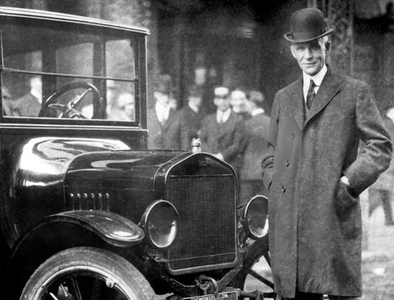

ADDITIONAL RESOURCES
If I asked people what they want, they would have said faster horses.
– Henry Ford
A lot of times people don’t know what they want until you show it to them.
- Steve Jobs
Notes:
The Kano method is great, though you may need some insight into “latent needs” in order to conduct the survey. Finding those insights is the art of product management.
The challenge with innovation and product development is summed up by two quotes from well known product innovators here in the US, Henry Ford and Steve Jobs. CLICK
When someone asked Henry Ford about whether he asked his customers what they wanted he said CLICK “if I asked people what they want they would have said faster horses”. CLICK
When Steve Jobs was asked a similar question, CLICK he said “A lot of times people don’t know what they want until you show it to them ”
Now, consider the processes they may have used to develop their products. They have inspired quite a bit of process innovation in identifying ways to uncover the input to truly great products.
While these are US based examples, I’d love to hear about similar examples from India in this week’s discussion board. I didn’t hear any the last time I asked this. It would be great to hear some this coming week.

Slide 50
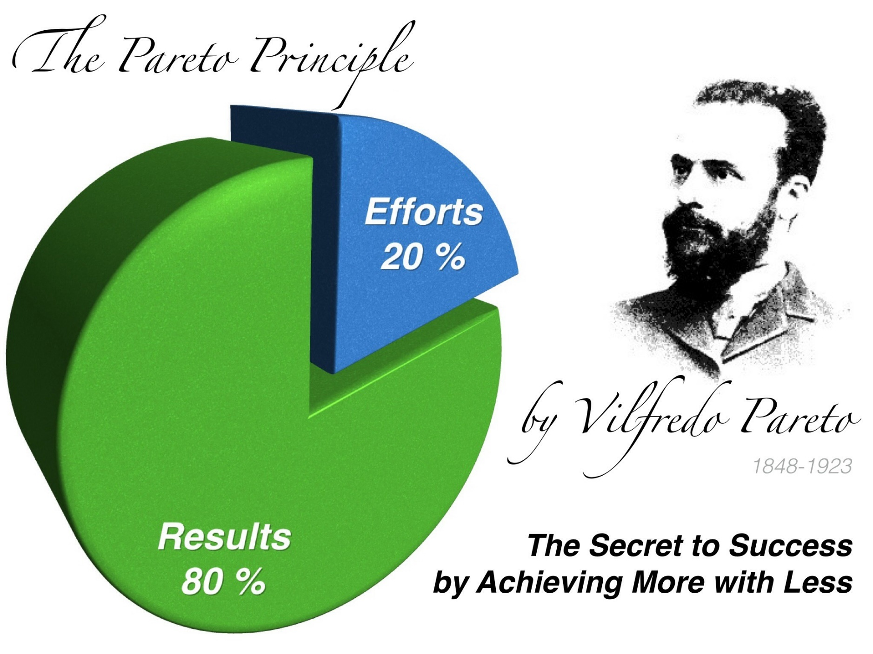
ADDITIONAL RESOURCES
Many of you have asked about how to prioritize your efforts with so many different features and requirements. We would suggest following the 80/20 rule, or the Pareto Principle.
Basically, 20% of the effort generates 80% of the results.
Notes:
Many of you have asked about how to prioritize your efforts with so many different features and requirements. We would suggest following the 80/20 rule, or the Pareto Principle.
Basically, 20% of the effort generates 80% of the results.

Slide 51

Over to you!

